Slide 1
Social Cognition

Slide 2
Social Cognition Thinking About the Social World Understanding the Social world
Social Cognition—how people interpret, analyze, remember, and use information about the social world

Slide 3

Rahul Gandhi’s address at Berkeley gets praise, brickbats on Twitter Congress vice-president Rahul Gandhi addressed students at the University of California, Berkeley, criticising the Modi government on its economic policies and handling of Kashmir conflict.
Follow
Shashi Tharoor
✔@ShashiTharoor
A speech marked by acuity & passion, & a discussion infused with candour & insight #RGinUS @UCBerkeley
7:48 AM - Sep 12, 2017
834834 Replies
1,0071,007 Retweets
Randeep S Surjewala
✔@rssurjewala
Eloquent speech, candid thoughts and open conversation marks Shri Rahul Gandhi's interaction at @UCBerkeley today. #RGInUS

Slide 4
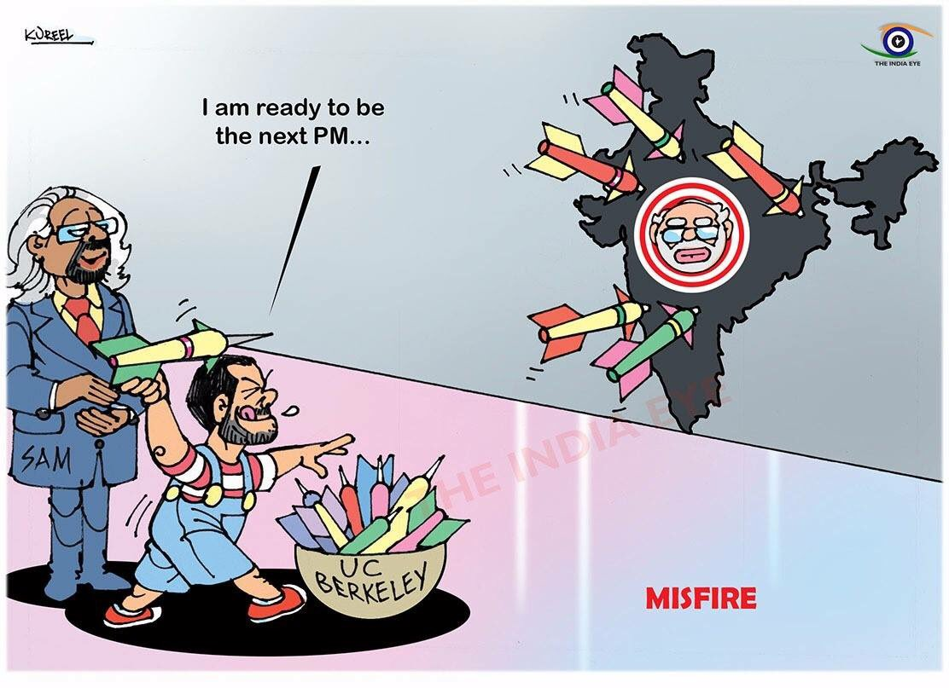

#SwamiVivekananda gave historic speech in Chicago. After 125 years, #Pappu will give his hilarious speeches in New York and California.
"Dynasty is how India runs." - #RGinUS. Tight slap to those self made men and women who see a hope in that #Pappu #IndiaRejectsRahul
MisFire of #Pappu causing Social Media Storm in #India
#RahulInsultsIndia #RahuHauntsUS #RahulBacksDynasty

Slide 5
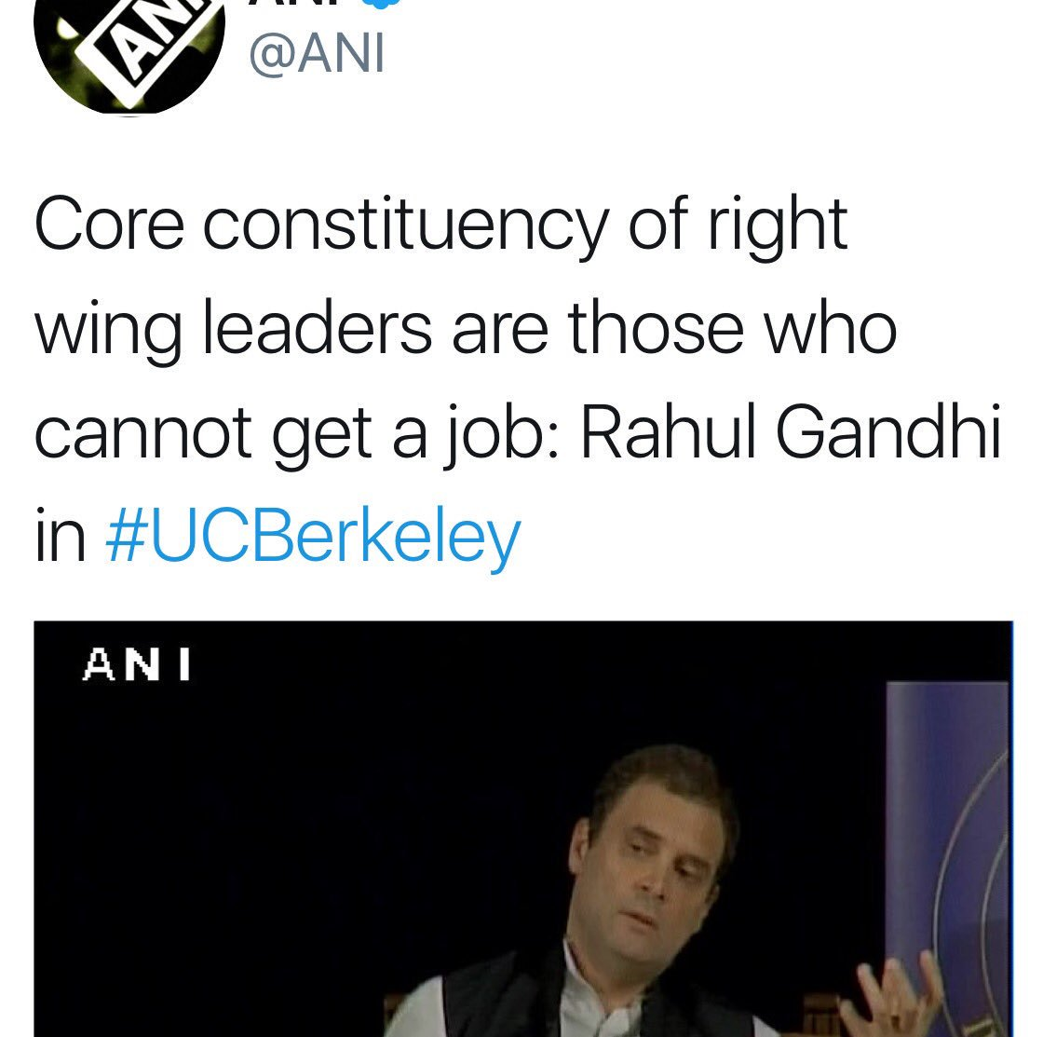
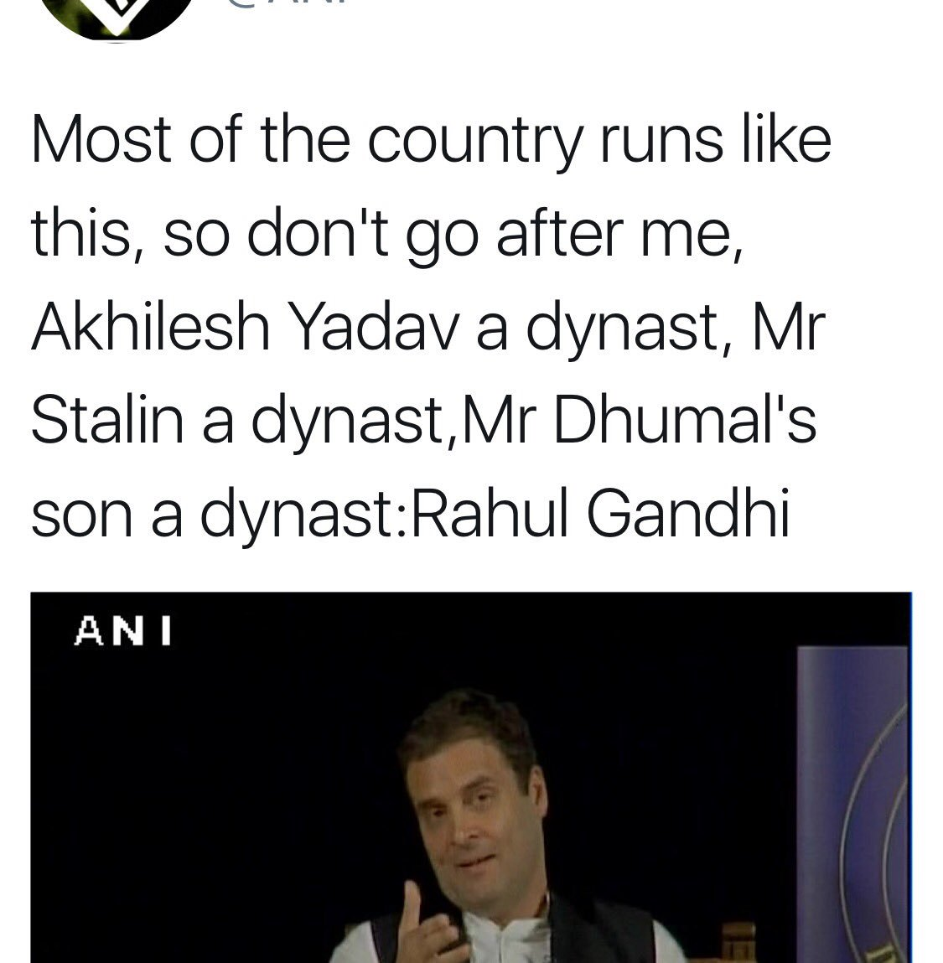
Sir Ravindra Jadeja‏ @SirJadeja Abhishek Bachchan Or Ambani Are Dealing With Their Personal Business, They're Not Thriving To Decide Public's Future Jagrati Shukla @JagratiShukla29 Defending dynastic rule in India? Havng made those statements at #Berkeley, #RahulGandhi shouldn't blame anyone for ridiculing his lack of..

Slide 6
Social Inference
Often the information available to us is incomplete, ambiguous, or contradictory.
Social cognition focuses on the way we use this information to arrive at coherent judgments.
People’s inferences are often marked by systematic biases.

Slide 7
Schemas & Prototype: Mental framework for Holding and Using information
Schema: Mental framework containing information relevant to specific situations or events, which one established help us interpret these situations and what’s happening in them
Heuristics: Mental models of the typical qualities of members of some group or cateogory.

Slide 8
Schemas influence three basic processes:
Attention (They affect what is noticed.)
Encoding (They affect what is stored in memory.)
Retrieval (They affect what is recovered from memory.)
Schemas are resistant to change.
Perseverance Effect—the tendency for beliefs and schemas to remain unchanged even in the face of contradictory information

Slide 9
Types of Schema
Person- schemas about people
“athlete”, “librarian”
Role- schemas relating to specific roles
“professor”, “student”, “physician”
Event (script)- indicates typical sequence of events
“restaurant”, “exam”, “first date”

Slide 10
Social Cognition: Attention, Encoding & Retrieval
Once the Schema is formed , Information consistent with them is easier to remember
When schemas are first being formed information inconsistent is easily noticed and thus encoded
Schemas also influence what information is retrieved from memory
Schemas:
Play a very important role in many forms of social interactions: Attitude, Stereotypes (Prejudice & discrimination) etc.

